Slide 1
Module 2: Wrapper Class and For each loop

Slide 2
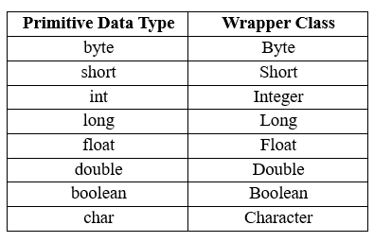
Wrapper Classes
Wrapper classes provide a way to use Primitive Data Types (int, double, char, float, byte, short, long, Boolean) as objects.

Slide 3
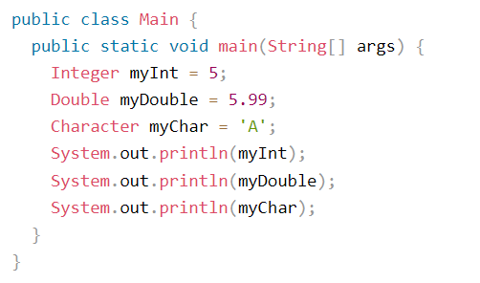
Creating Wrapper Objects
Use the wrapper class instead of the primitive type.

Slide 4

Java Autoboxing
The Java compiler automatically converts primitive types into their corresponding wrapper class objects.

Slide 5

Java Unboxing
The Java compiler automatically converts wrapper class objects into their corresponding primitive types.

Slide 6

For-Each Loop
is used exclusively to loop through elements in an array

Slide 7
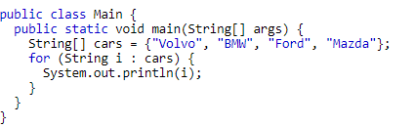

Example 1

Slide 8
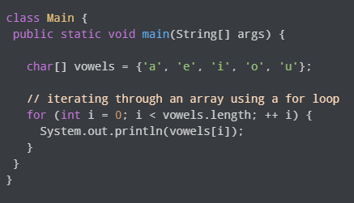
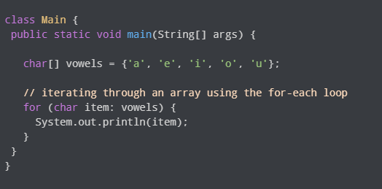
Difference between For Loop and For-Each Loop
For Loop For Each

Slide 9
Try
Create an array having integer values and find the total sum of the elements in the array using the For-Each loop.
Create an array having integer values and multiply each element in the array by 2 and print the output using For-Each loop.

Slide 10
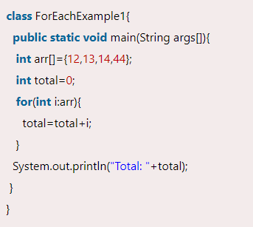

1.

Slide 11
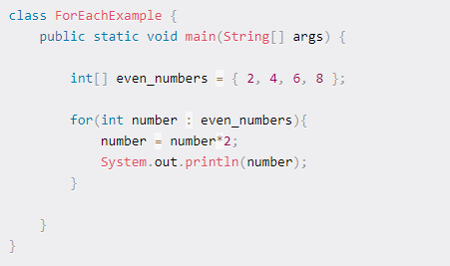
2

